Slide 1
CT Flow Activated Releasable Overshot
Document No:07
Editor: Jalal Alali
2017.03

Slide 2
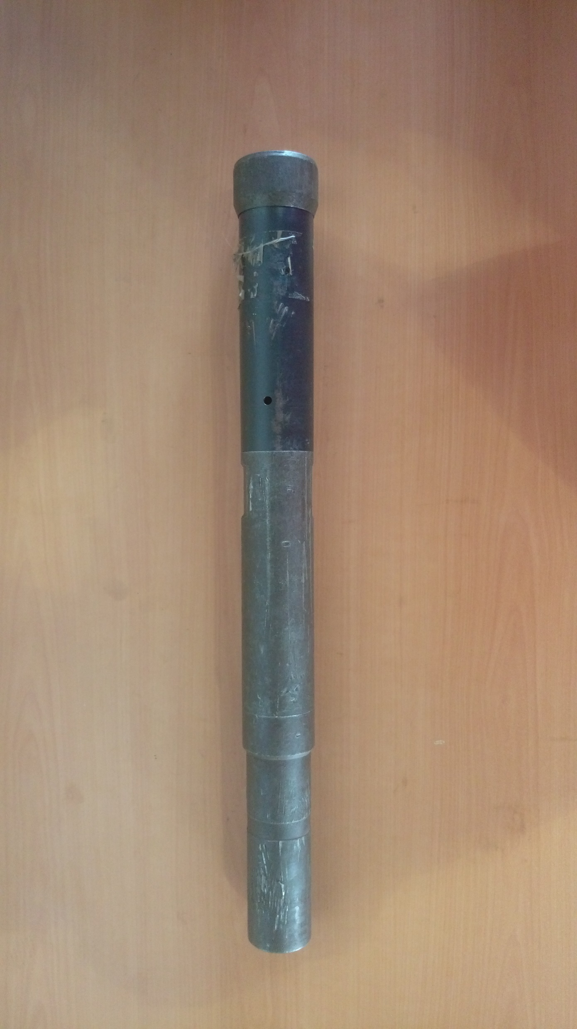

Slide 3
CONTENT
Introduction of CT Flow Activated Releasable Overshot
Disassembly
Assembly
CT Flow Activated Releasable Overshot معرفی
نحوی جدا سازی قطعات
نحوی سر هم کردن قطعات

Slide 5
Introduction:
The Flow Activated Coiled Tubing Releasable Overshot is a variable catch external overshot used to retrieve a lost cylindrical fish from the well bore.
A complete range of hardened and double tempered slips are available for each size tool. These tools are available in all sizes from 1” to 4” diameter with slips to suit.
معرفی:
این ابزار یک آرواره زبرین با دهانة متغیر است که برای بازیابی ابزار استوانه ای بازمانده درون چاه استفاده میگردد.
بازه کاملی ازدندانه های های دو برابر ناخنک کاری شده و سخت شده برای هر اندازه از ابزار موجود است. این ابزارها در تمامی اندازه ها از قطر 1 تا 4 اینچ به همراه دندانه های مناسب هر یک در دسترس می باشند.

Slide 6
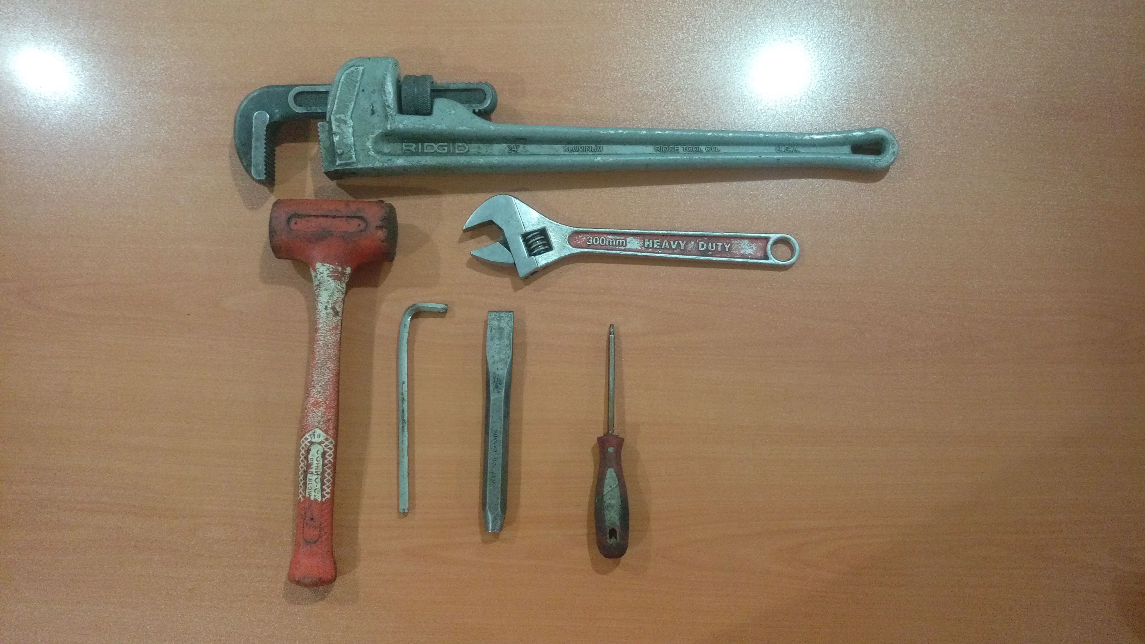
Required hand tools
ابزار مورد نیاز
Pipe Wrench
Allen Key
Rubber Hammer
Bowl
Flat Bar
Screwdriver

Slide 7
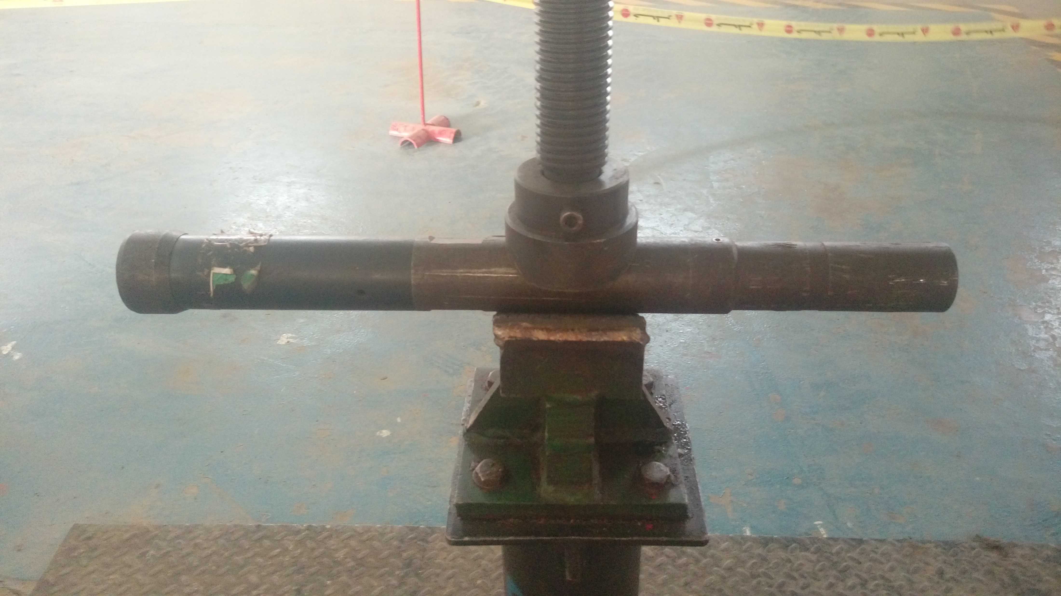
Disassembly
Place Body In The Vice

Slide 8
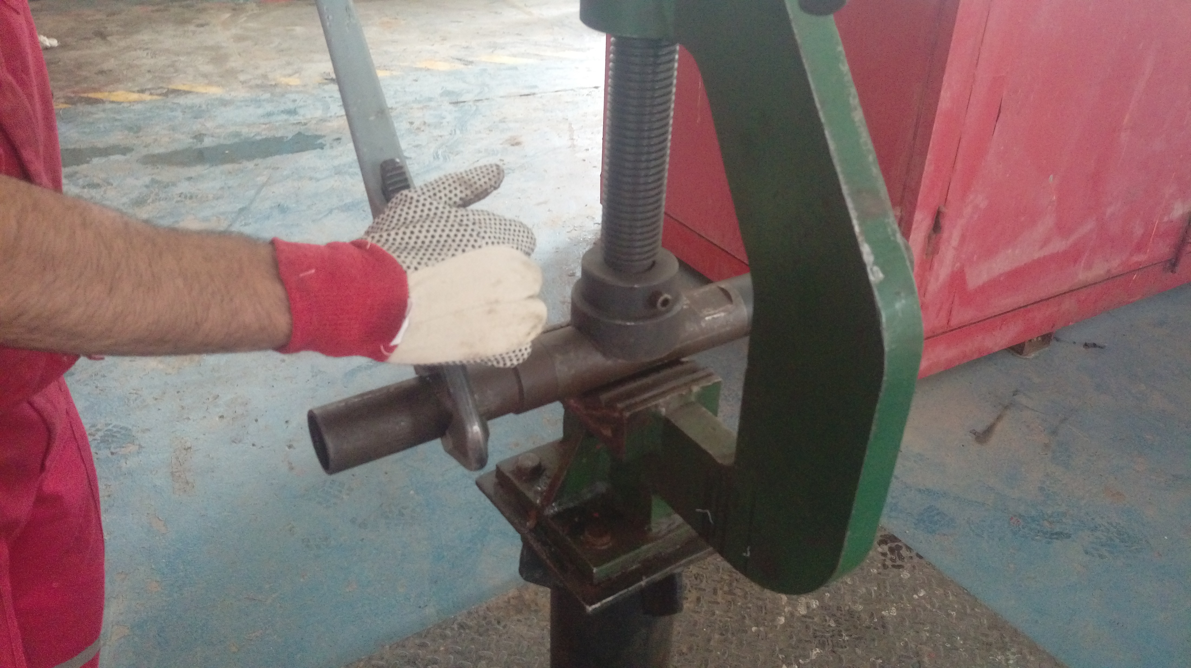
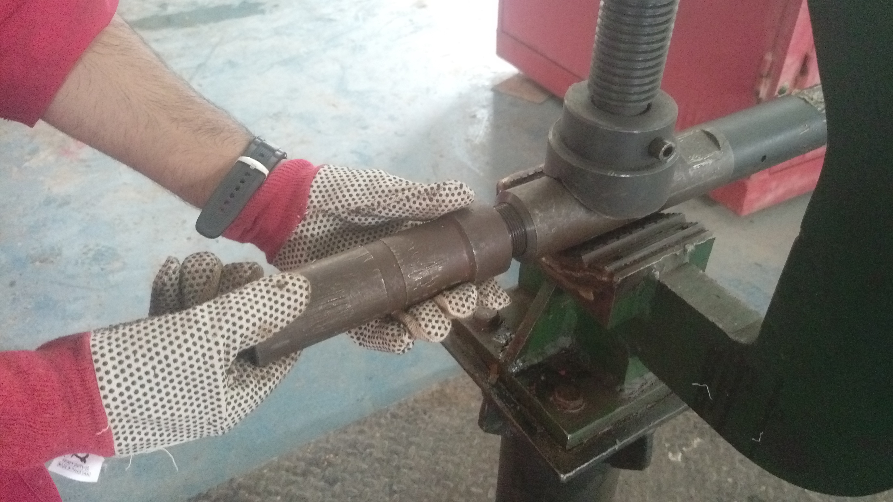
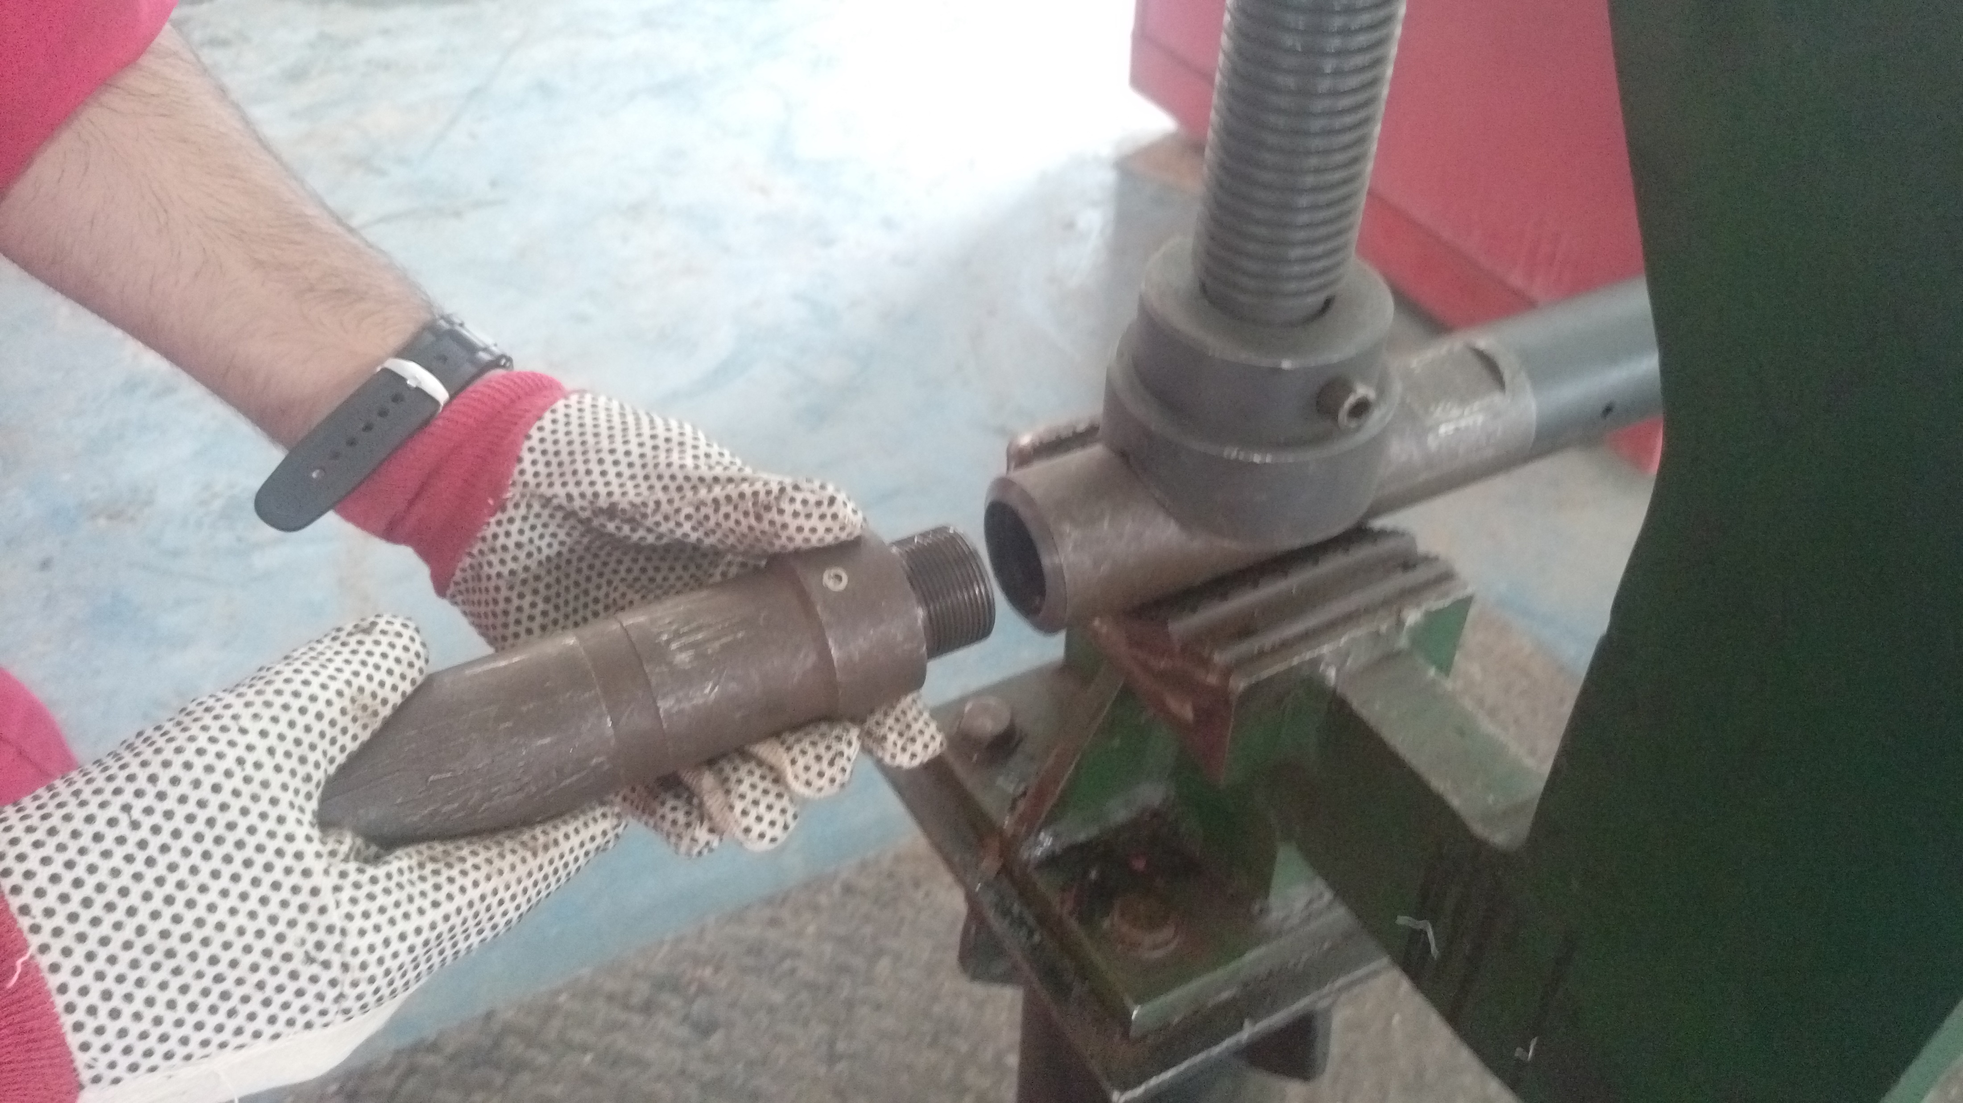
Unscrew Top Sub From Body
A
B
C

Slide 9
Unscrew Guide From Bowl
A
B

Slide 10
Unscrew Bowl From Body
A
B

Slide 11
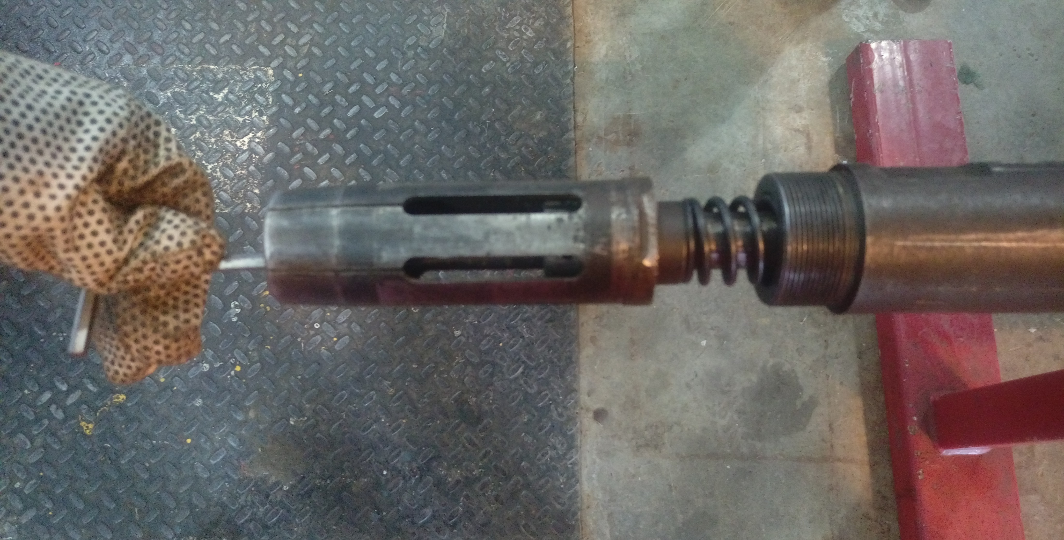
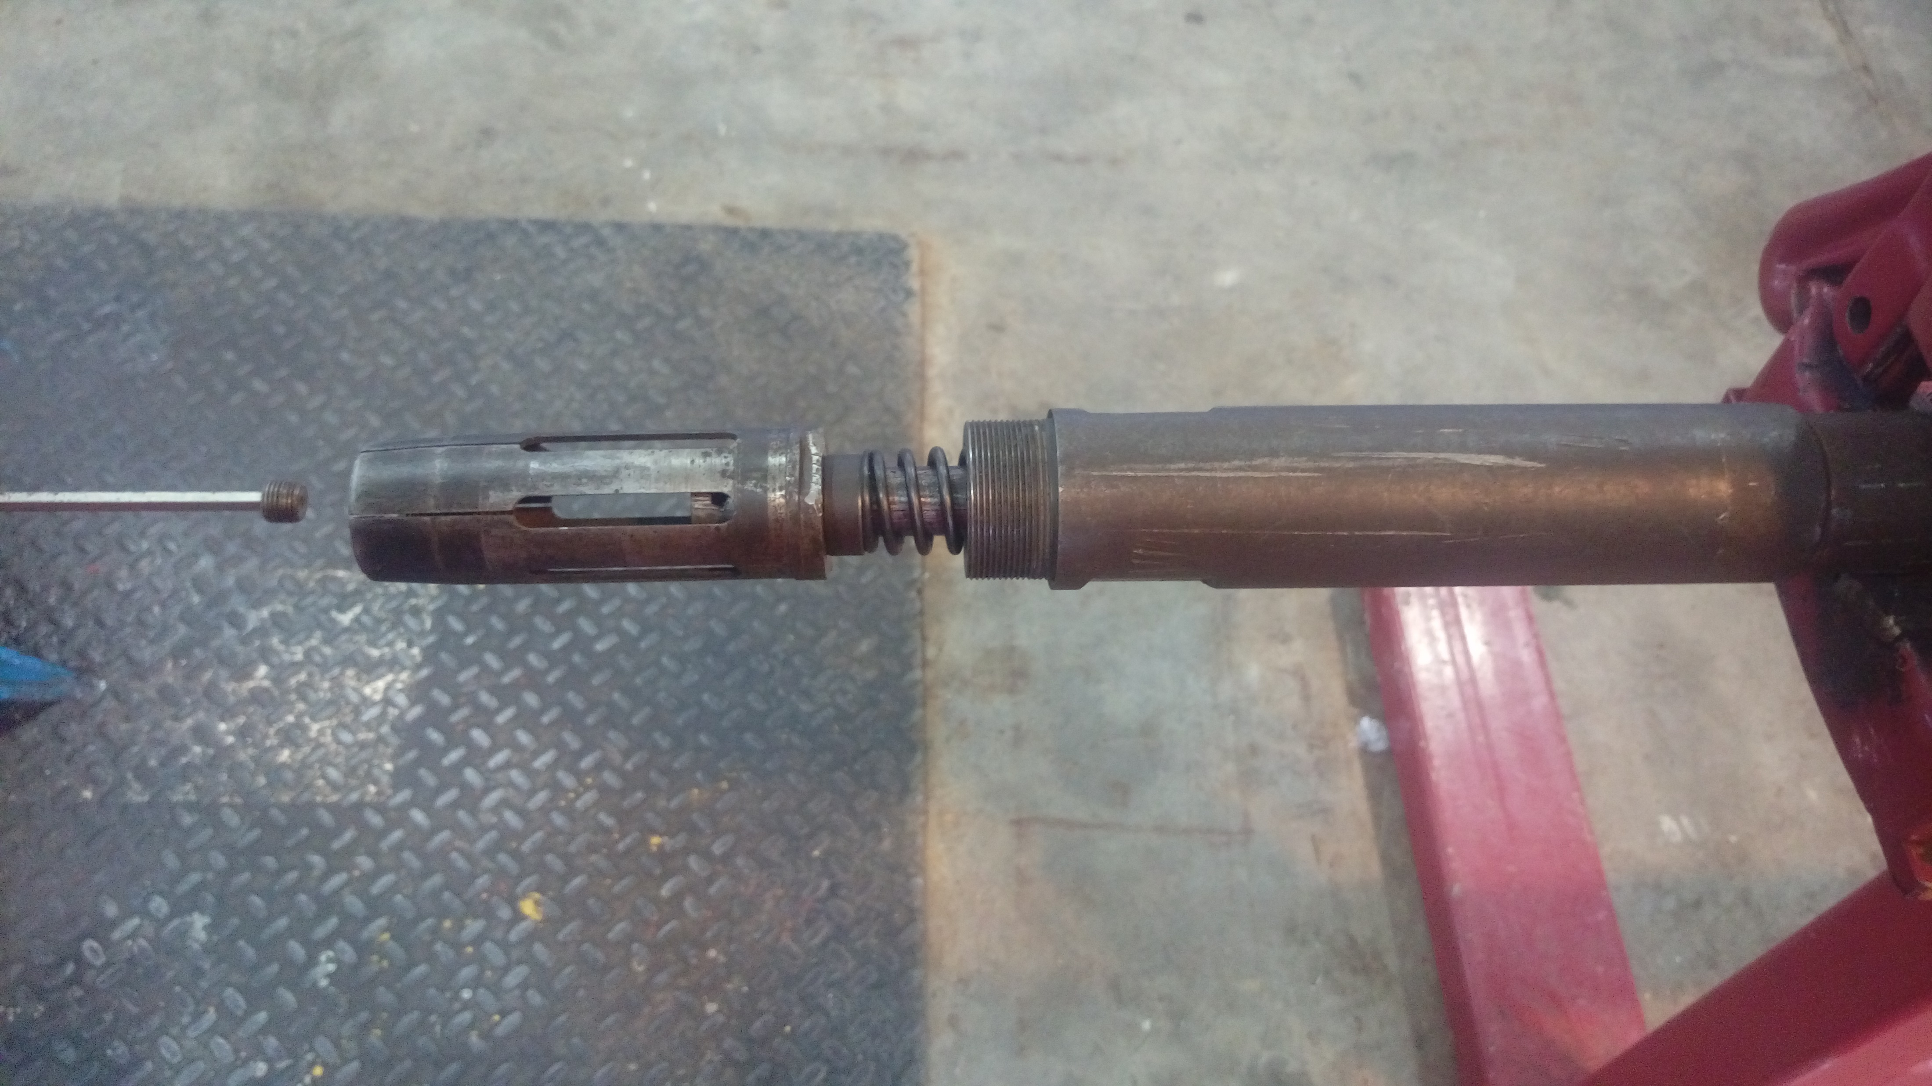
Unscrew Choke Bean From Lower Core
A
B

Slide 12
Take-Off Lower Core From Upper Core By Using Flat Bars In Slots At Either End Of Core Assembly
Note:
Upper Core will have to be held steadily by using flat bars in slots at either end of core assembly.
A
B
_{C}
D

Slide 13
Unload Upper Core From Body
A
B

Slide 14
Extract Core Spring And Lower Core From Collet
A
B

Slide 15
Unscrew Choke From Lower Core
A
B

Slide 16
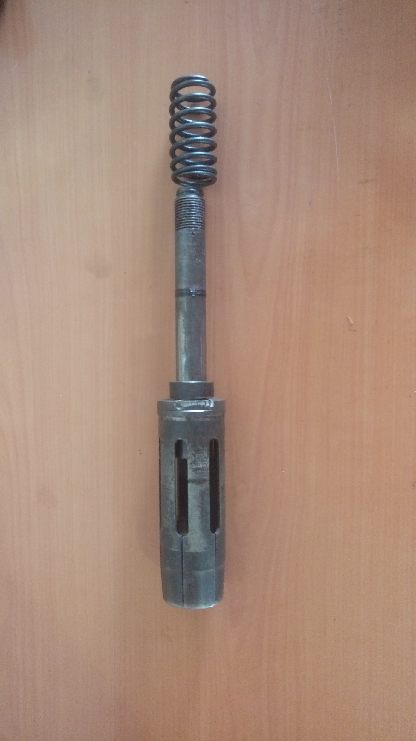
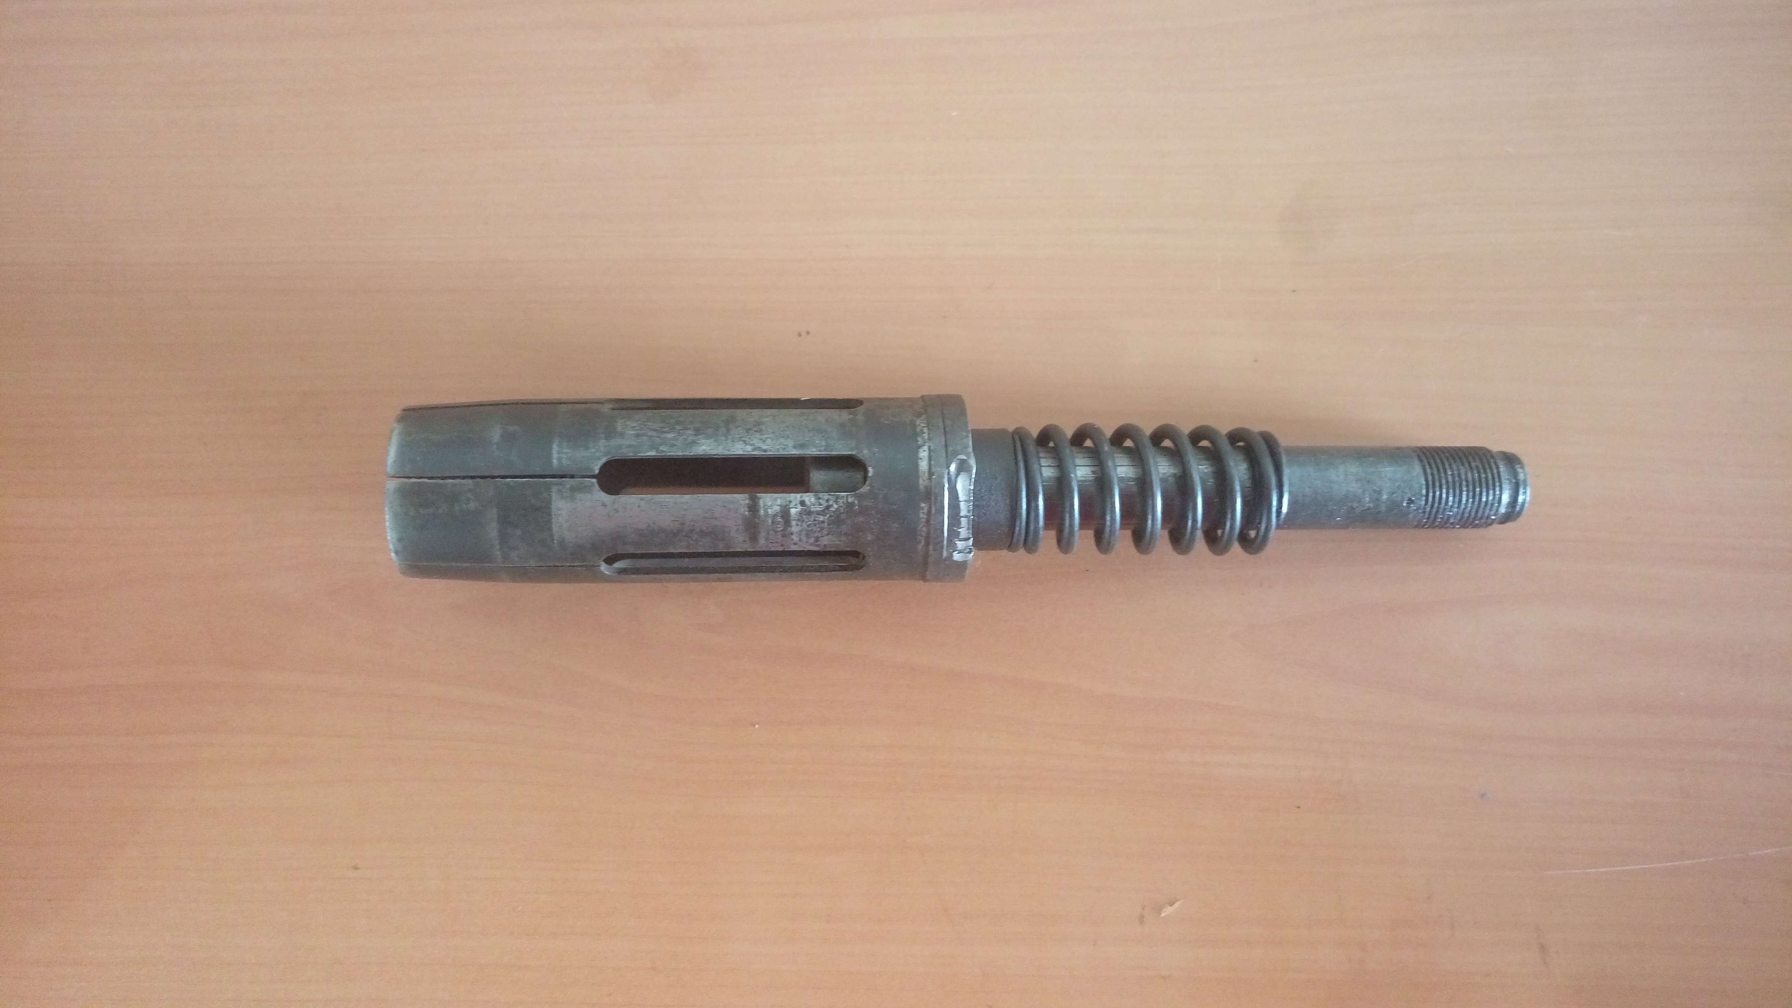
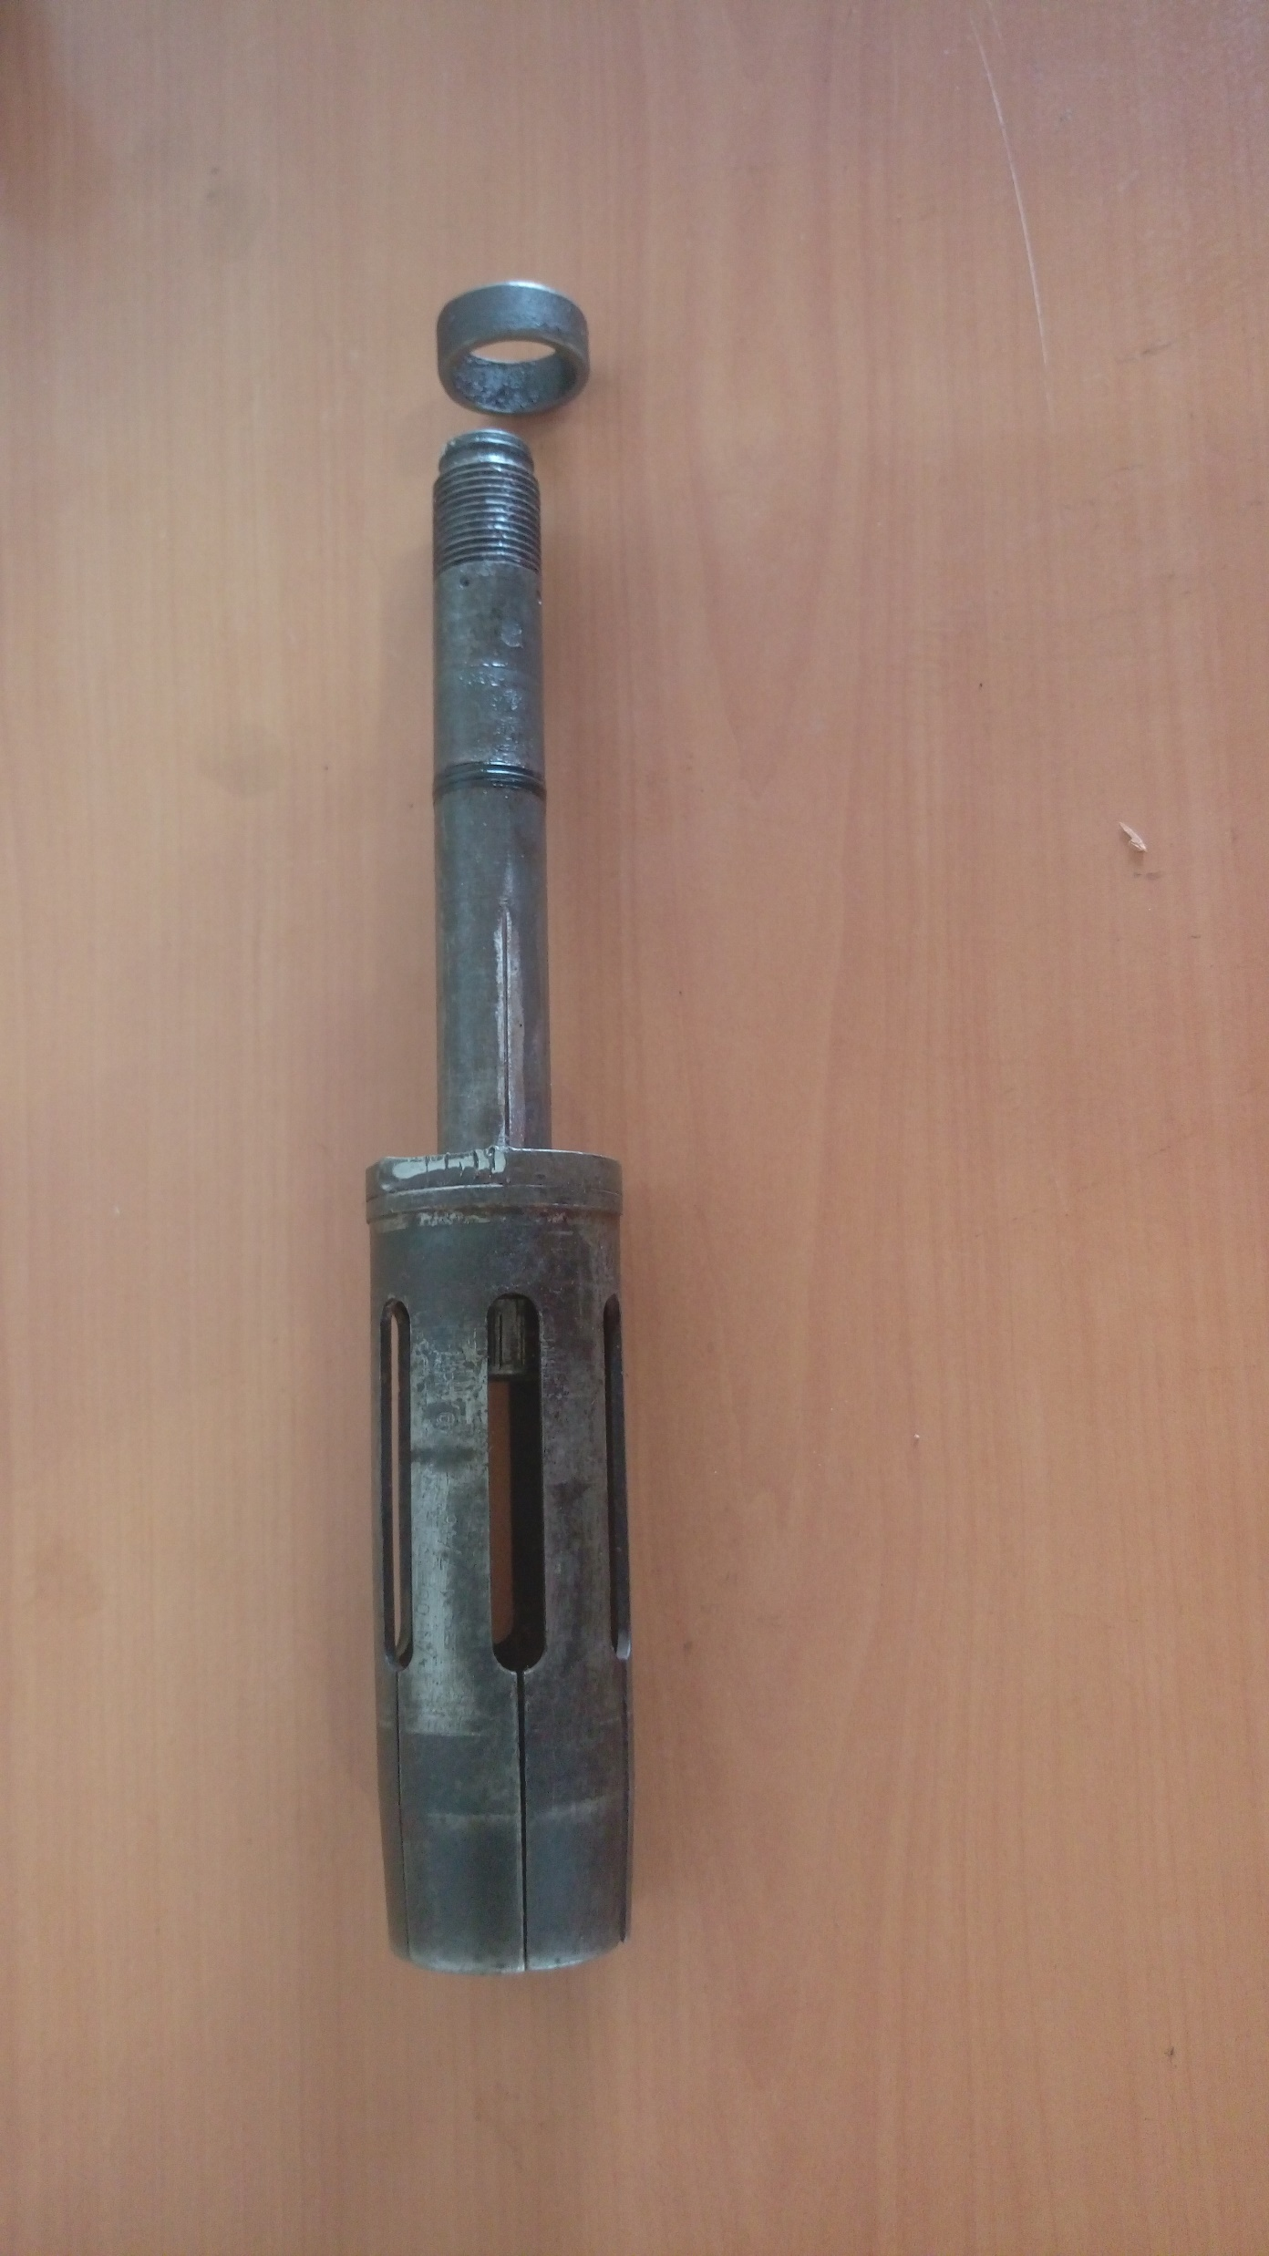
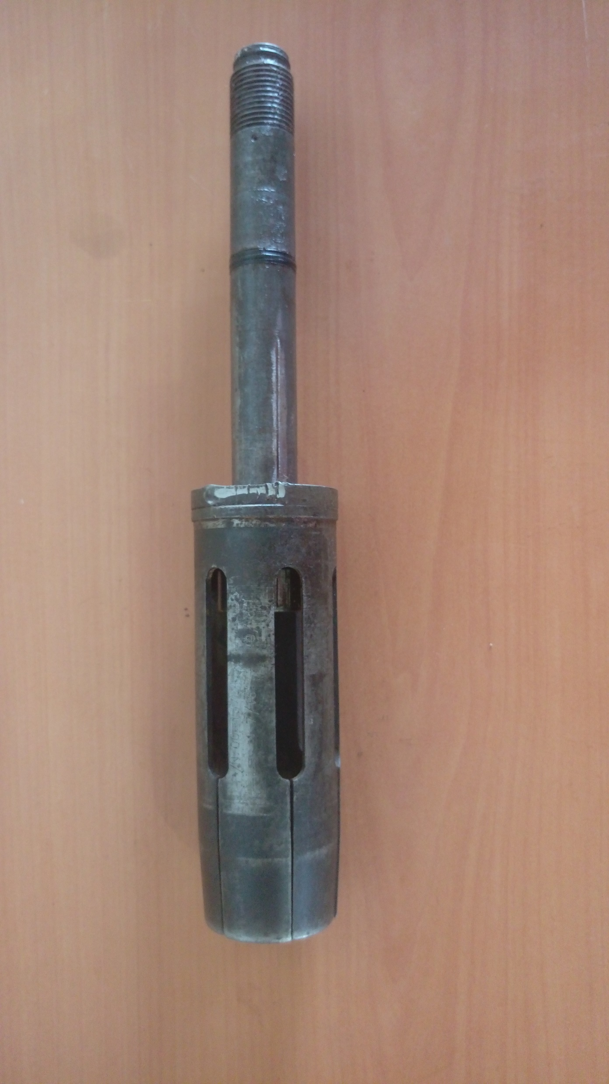
Remove Core Spring And Collet From Lower Core
A
B

Slide 17
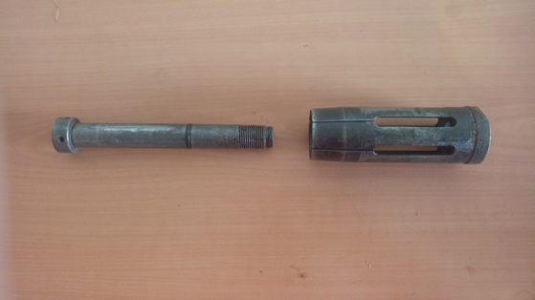

Slide 18
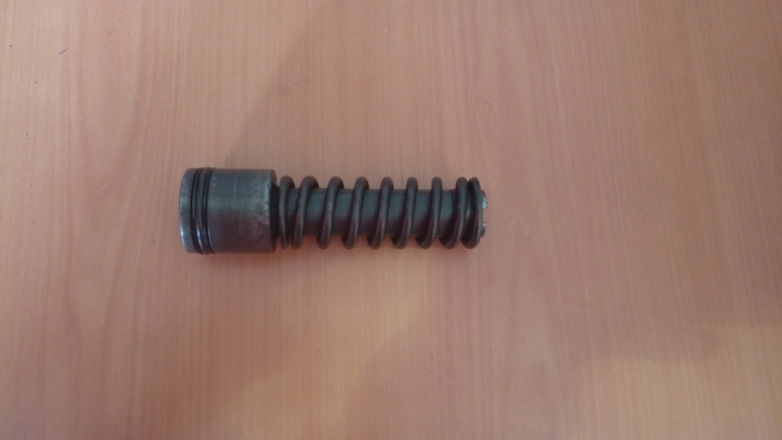
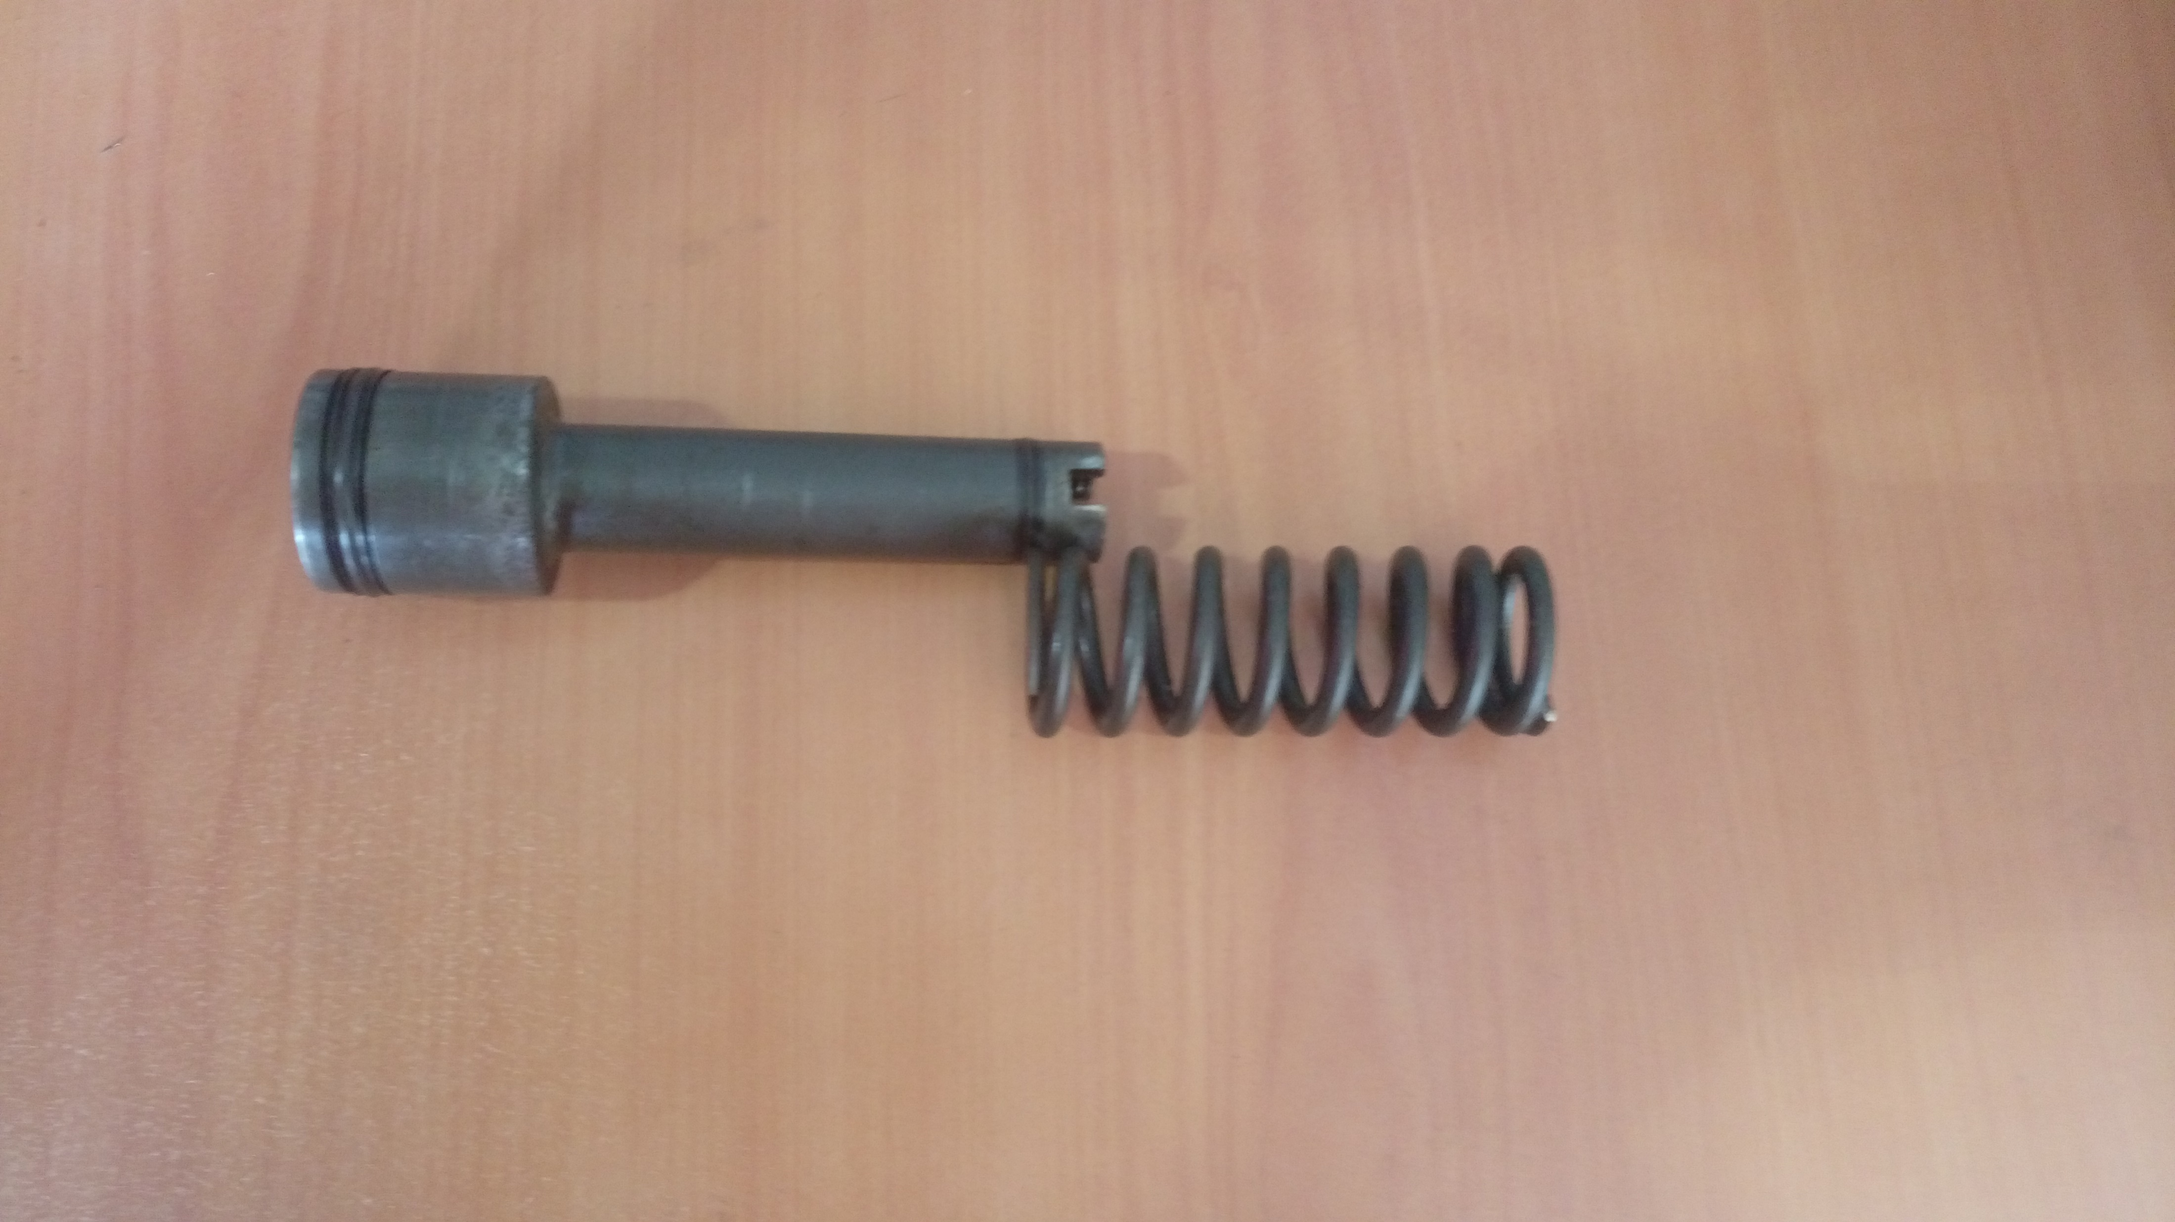
Remove Main Spring From Upper Core
A
B

Slide 19
Assembly
Place Body In Vise

Slide 20
Make Up Choke Bean Into Lower Core
A
B

Slide 21
Place Collet And Spring Over Lower Core And Locate Onto Back Of Retainer Sub
A
B

Slide 22
Load Upper Core Into Body
A
B

Slide 23
Insert Top Of Lower Core Into Bottom Of Body And Make Up Lower Core To Upper Core
*Note: Upper Core Will Have To Be Held Steady For Initial Make Up
B
A

Slide 24
Slide Bowl Over Collet And Make Up It To Body
A
B

Slide 25
Place Main Spring Into Top Of Body
A
B

Slide 26
Make Up Top Sub To Body
B
A

Slide 27
Make Up Guide To Bowl
B
A

